Slide 1



Case Study Rockbuster Stealth
Haley Bustle
September 2023

Slide 2
Project Tools and Resources
Project Duration: four weeks
Project Resources
Rockbuster Stealth dataset provided by Career Foundry for educational purposes only containing records on film inventory and customer payments
Tools Utilized
PostgreSQL: relational database hosting the Rockbuster dataset; utilized for analyzing customer rental patters and company sales history
Microsoft Office: Excel for refining SQL query outputs to spreadsheets; PowerPoint to assemble and present a detailed analytical report
Tableau Public: transform Excel data into visual representation of customer trends and company sales

Slide 3
Project References and Data Sources
PostgreSQL Rockbuster Stealth LLC Dataset
Final Report link to GitHub
Tableau Public for Visualizations
Not all visualizations created were used for the final project

Slide 4
What is the Rockbuster Stealth LLC Project?
Fictious company and dataset provided by Career Foundry for educational purposes
Project aims to understand Rockbuster Stealth inventory and customer data
Identify genre and rental rate popularity and understand customer rental habits
Objective of project is to help create a competitive online movie rental service
Study customer behavior to develop rewards program for returning customers
Develop strategy to integrate new titles based on historical data of most popularly rented genres

Slide 5
Project Challenges
Dataset does not contain citation document for data collection, including any potential bias or errors
Challenge’s the reliability and authenticity of any insights gathered from analysis in terms of practical business use
Restriction to SQL queries to examine data; dataset not viewable in Excel
Limit's ability to cross-verify SQL query and visualization accuracy
Navigation of complex dataset using only precise SQL queries

Slide 6
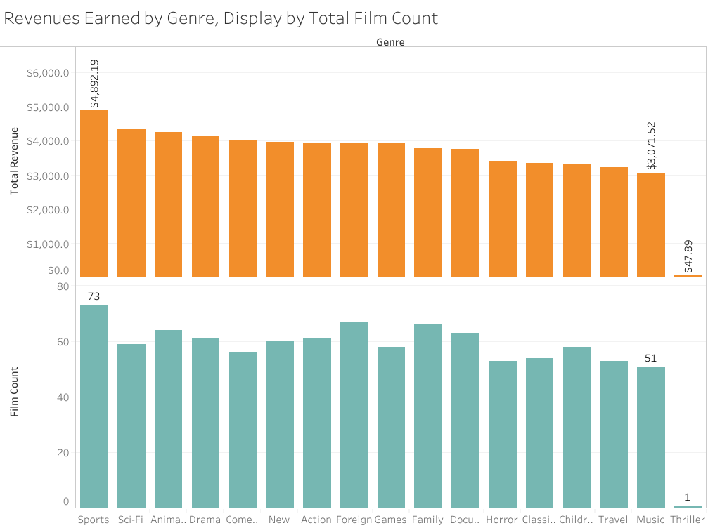
Project Insights: Film Revenue by Genre
Highest grossing film category is sports: 73 titles for total revenue of $4,892.19
Least grossing category is music: 51 titles for $3,071.52
Outlier film category: Thriller has 1 title and $47.89 in total revenue
Can confidently conclude that higher quantity of film titles does not always translate to higher revenue

Slide 7
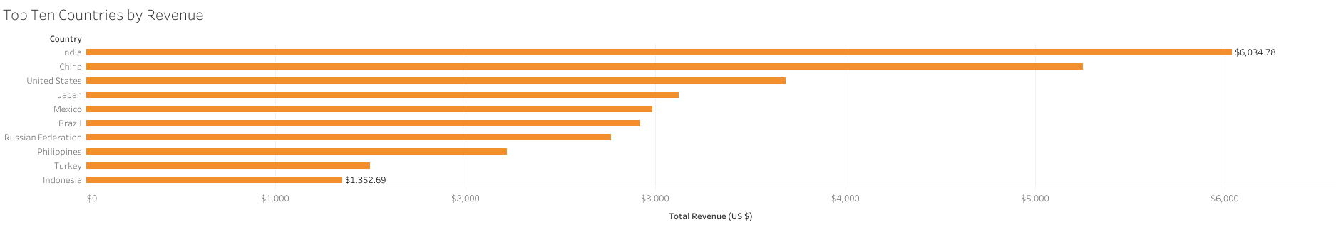
Revenue by Country
Top five countries by revenue are:
1) India, $6,034
2) China, $5,251.03
3) United States, $3,685.31
4) Japan, $3,122.51
5) Mexico, $2,984.82
Customers within top five countries:
1) India, 60
2) China, 53
3) United States, 36
4) Japan, 31
5) Mexico, 30

Slide 8
Project Conclusions and Remarks
Project & Analysis Challenges
Project requested for business application in 2020, cannot confirm the date this data was collected and therefore cannot guarantee appropriate application of results
Further investigation required to determine if films are correctly categoried and therefore accurately representing revenue earned/customer popularity
Further investigation required to determine if count of customers is accurate and thus, the count of customers and revenue by country earned is accurate
Analysis Development
Data suggest creating new rental categories and distributing customer surveys to gauge customer response; adjust pricing and genre availability based upon surveys and revenue data
Focus efforts on marketing and advertising in top ten listed countries
Establish rewards program for returning customers for both physical and digital film rentals

Slide 9
Thank you!

